Slide 1
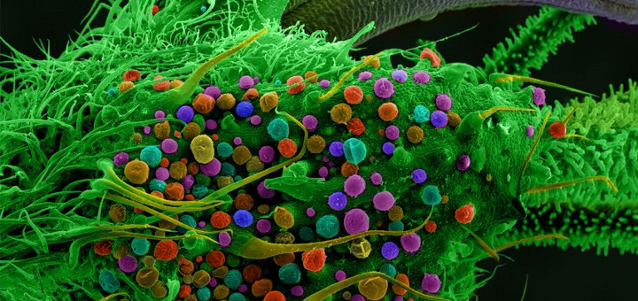
The Expanding Potential of Cannabis in Health Care Kevin and Peter Choo Cell Physiology 6/1/15

Slide 2
Therapeutic History of Cannabis
Cannabis has been known to have been in therapeutic use by humans for centuries. Evidence points to at least the last 6000 years of human history.
Ancient civilizations documented the medicinal value of cannabis, promoting it for its healing powers, anti‐inflammatory properties, and as a treatment for many different disease states.
19th Century cannabis saw widespread use in Europe to treat conditions such as pain, spasms, asthma, sleep disorders, depression, and loss of appetite. (Gaoni, Y. and Mechoulam, R. J. Am. Chem. Soc. 1964)

Slide 3
Cannabis in Modern Medicine
Post 19th century, many therapeutic uses for cannabis have been validated through modern research.
Research in general has been hindered by the legal status of cannabis.
Changing legal status has allowed for recent research, where cannabis has proven effective in the treatment of chronic neuropathic pain, glaucoma, multiple sclerosis, HIV, cancer, and other conditions associated with chronic pain. (Borg GY et al, Pharmacotherapy, 2013)
There are millions of cannabis users in the U.S. and worldwide. Whether it be medicinal or recreational, you will encounter patients who use cannabis.

Slide 4
Overview: How Cannabis Works
A brief introduction to the important biomolecules of cannabis: Δ-9 tetrahydrocannabinol (THC) and related cannabinoids.
An example of how THC and cannabidiol bind to specific, endogenously produced receptors (cannabinoid receptor’s 1 and 2) of the brain and body to elicit a physiological response through modulation of signal transduction pathways.
Some of the physiological changes in the body that occur as a result of cannabis use.

Slide 5
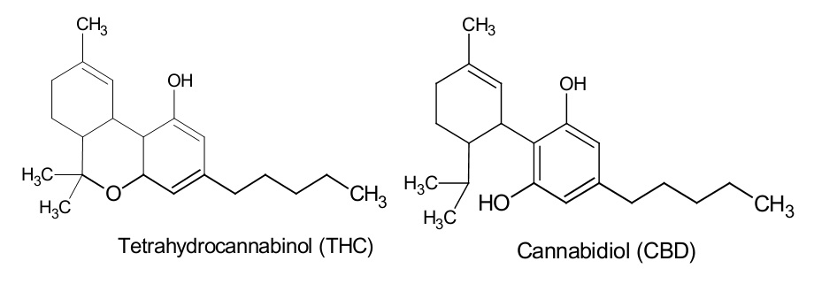
The Discovery of THC and CBDs
The major psychoactive cannabinoid, Δ-9 Tetrahydrocannabinol (THC) was first isolated in 1964.
Recent studies have demonstrated that cannabidiol (CBD), a cannabinoid with reduced or no psychoactive properties, has pronounced antiepileptic therapeutic effects. (Jones NA et al, J Pharmacol Exp Ther. 2010)

Slide 6
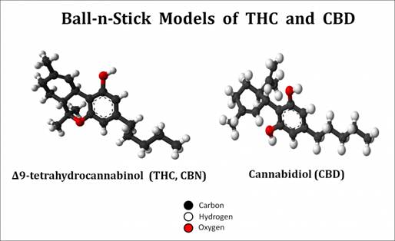
Chemical Similarity of THC and CBD
Organic, made of C-H-O
THC and CBDs are isomers. (Lecture 2)
CBD becomes THC under acidic conditions (Lamarine RJ, J Drug Educ. 2012)
Lipophilic – hydrophobic, stored in fats

Slide 7
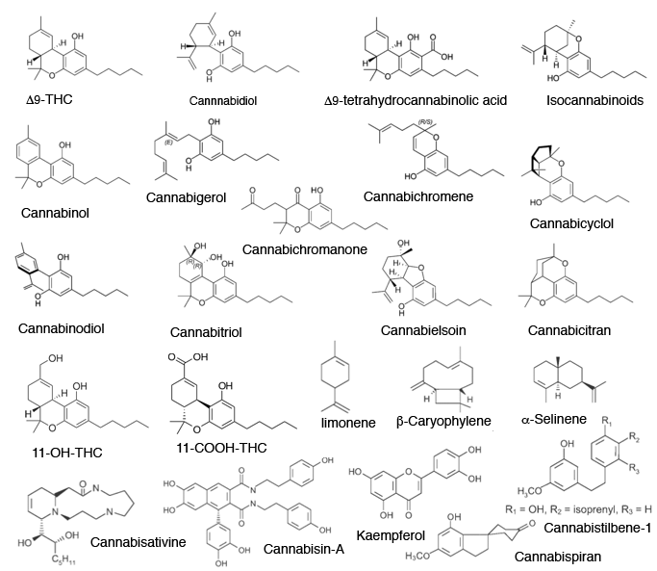
Competent Incompetence
60+ cannabinoids have been isolated, most of which we know very little about.

Slide 8
Cannabinoid Cell Signalling
Activate cannabinoid receptors CB1 and CB2. Both receptors are localized in the brain and peripheral tissues. Typically CB1 expression is highest in the brain, whereas CB2 receptors mediate immune responses in the periphery.
The receptors ENDOGENOUSLY (naturally produced by the body) exist to receive ENDOGENOUSLY produced cannabinoids, including THC. (Grotenhermen and Muller-Vahl, Dtsch Arztebl Intl. 2012)
Cannabinoids activate G-protein coupled signal amplification (which ultimately influences transcription and translation) in areas of the central nervous system dedicated to the mediation of pain, memory, and other key functions. (Maroof N, Pardon MC, Kendall DA. Biochem Soc Trans, 2013)

Slide 9
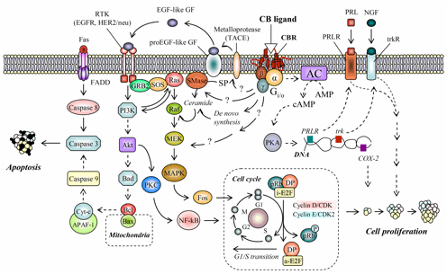
CB1 Signaling in a Tumor Cell
CB1 and CB2 are ligand gated GPCRs, binding of CBD/THC causes dissociation of the αβγ heterotrimer. Inhibitory in tumor cells.
α subunit activates adenyl cyclase (AC), produces cAMP which activates PKA, eventually modulating transcription and translation. Stops cell proliferation.
βγ subunits activate the RTK homodimer which leads to autophosphorylation of downstream targets.
RTK eventually activates cytochrome c. Programs cell for apoptosis.

Slide 10
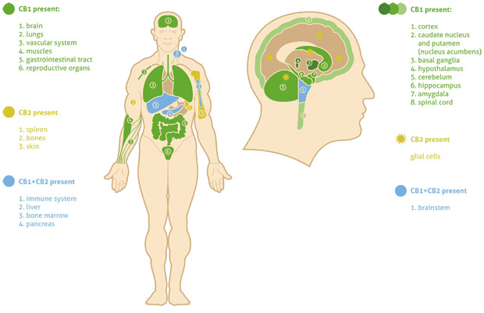
CB1 expression is highest in the brain.
CB2 receptors mediate immune responses in the periphery.

Slide 11
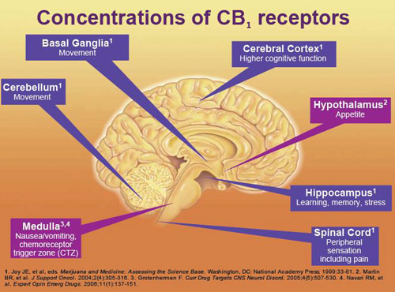
Effects of Cannabis in the Brain
Causes release of dopamine in reward centers of the brain, resulting in euphoria.
Affects spinal cord modulation of nociception. Cannabinoids block the amplification but not the initial transmission of pain.

Slide 12
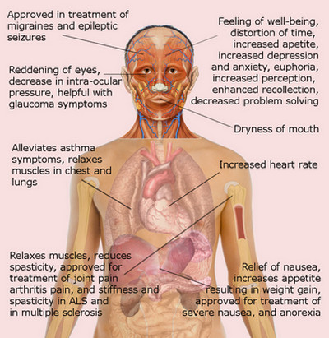
Effects of Cannabis on the Body
Good for school:
Treatment of migraines
Euphoria
Increased Perception
Enhanced Recollection
Relaxes muscles, relief of joint pain
Bad for school:
Decreased problem solving
Potential for increased depression/anxiety
Increased heart rate
Increase in appetite and weight gain

Slide 13
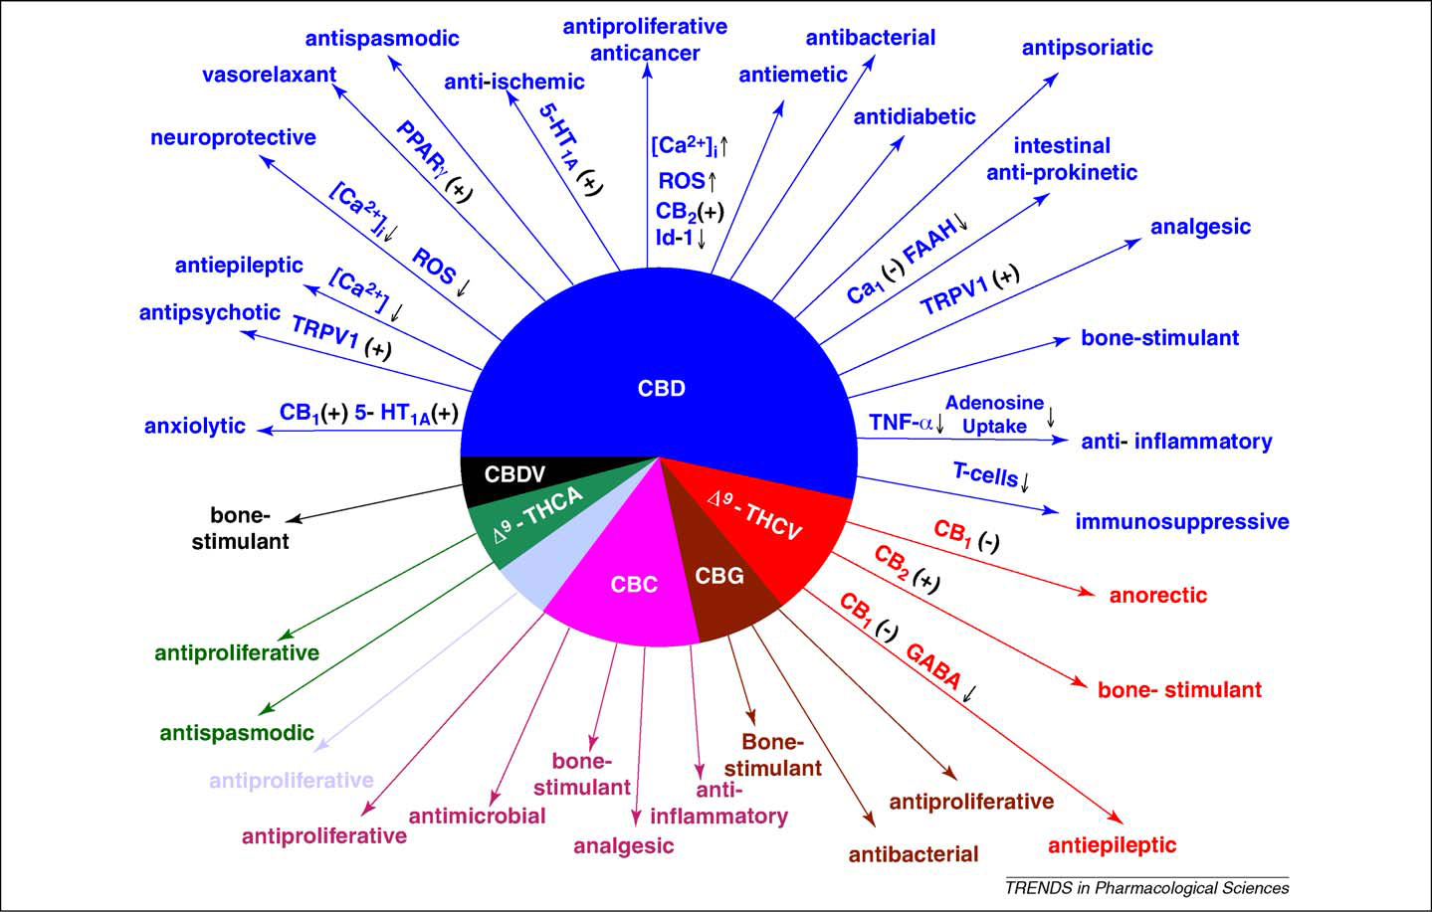
Just Scratching The Surface
Remember, there are over 60+ cannabinoids to date, with a high potential for more to be discovered.
This chart is representative of only 7, and more therapeutic uses for these may still be found.

Slide 14
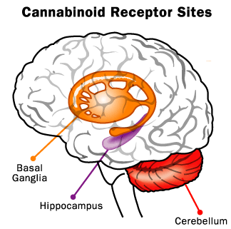
Potential Negative Effects
-Affects communication between BG and cerebellum affecting coordination, hippocampus affecting short term memory. Acute tendency towards reduction in social activity.
-Impaired cognitive development in teenagers. Effects are negligible in the early 20’s. (Leung L. J Am Board Fam Med. 2011 )
-First time or novice users occasionally develop anxiety, paranoia, and demonstrate impaired driving ability.
-Smoke inhalation has not been shown to be carcinogenic but is also not recommended.

Slide 15
Scientific Summation
THC and associated cannabinoids are isomers of the cannabis plant.
Activate endogenous signaling pathways of CB1 and CB2 receptors via G protein coupled signal transduction.
The pathway modulation induces a variety of physiological responses in the body.

Slide 16
Clinical Significance
158.8 million users worldwide, 94 million people in the U.S. have admitted using it at least once. (NIDA survey 2013)
What is your professional or philosophic standpoint, is cannabis a drug or vitalistic (CB1 and CB2 receptors are endogenous)?
MDs are working on a protocol to determine when and when not to prescribe, so should you. Educate yourselves in the event that you are approached by a patient for advice. Be aware of the potential pros and cons involved.
Consider how a patient’s use of cannabis will affect your adjustment and how you carry yourself in the clinic.
Be smart if you elect to use cannabis in your personal life.

Slide 17
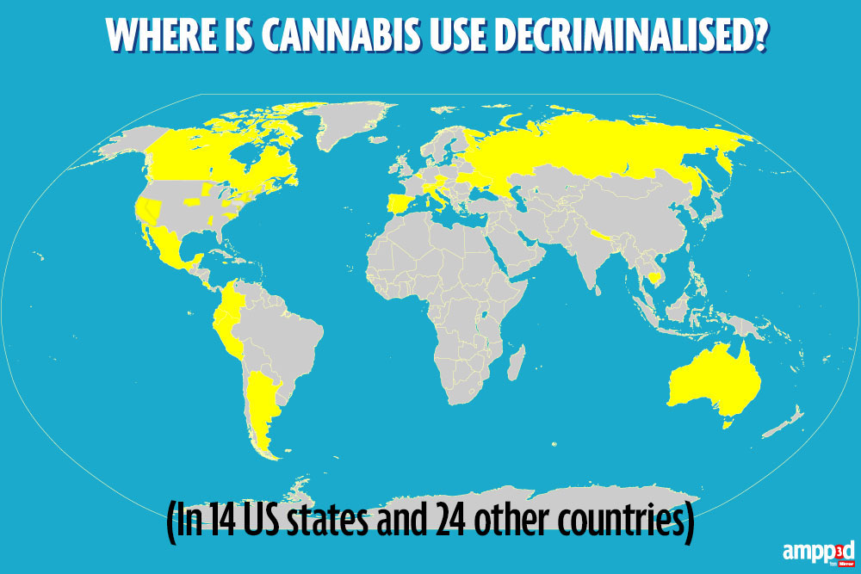
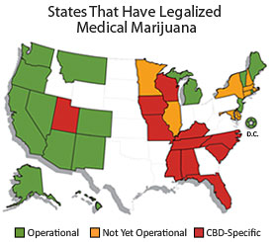
Cannabis in Your Workplace?

Slide 18

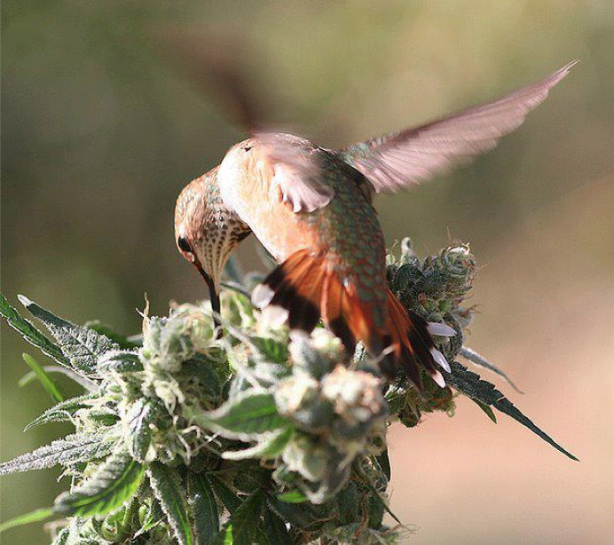
FUN FACTS
No recorded deaths in human history due explicitly to acute cannabis overdose.
The seeds of cannabis are non-psychoactive and are one of the most nutritious foods on earth. They contain the building blocks for all the essential amino acids and fatty acids necessary to human life.
Deficits in motor impairment and cognitive function are mostly non-existent in more experienced users.
The U.S. spent $221 billion between 2000-2010 enforcing cannabis laws.

Slide 19
References
Marijuana: modern medical chimaera. Lamarine RJ J Drug Educ. 2012; 42(1):1-11.
The pharmacologic and clinical effects of medical cannabis. Borgelt LM, Franson KL, Nussbaum AM, Wang GS Pharmacotherapy. 2013 Feb; 33(2):195-209.
Cannabis and its derivatives: review of medical use. Leung L. J Am Board Fam Med. 2011; 24:452-462
The pharmacologic and clinical effects of medical cannabis. Borg GY. and Mechoulam, Relt LM, Franson KL, Nussbaum AM, Wang GS Pharmacotherapy. 2013 Feb; 33(2):195-209.
Cannabidiol displays antiepileptiform and antiseizure properties in vitro and in vivo. Jones NA, Hill AJ, Smith I, Bevan SA, Williams CM, Whalley BJ, Stepens GJ. J Pharmacol Exp Ther. 2010 Feb;332(2):569-77.
The Therapeutic Potential for Cannabis and Cannabinoids. Grotenherman F, Muller-Vahl K. Dtsch Arztebl Intl., 2012 Jul; 109(29-30):495-501
The molecular basis of cannabinoid action in cancer. Fogli S, Breschi MC, Cancer Therapy 6, 103-116, 2008.
Endocannabinoid signaling in Alzheimer’s Disease. Maroof N, Pardon MC, Kendall DA. Biochem Soc Trans, 41(6); 1583-87, 2013
Isolation, structure and partial synthesis of an active constituent of hashish. Gaoni, Y. and Mechoulam, R. J. Am. Chem. Soc. 1964; 86: 1646–1647

